Slide 1
From yesterday
1. 2² x 2³ = 2. a³ x a² =
3. 2.21⁴ x 2.21⁶ = 4. 17⁶ ÷ 17⁴ =
5. y⁶ ÷ y³ = 6. r⁹ x r³ ÷ r⁶ =

Slide 2

Task – Write in expanded form
$5^{2}$
${\left(25\right)}^{3}$
${\left(5×5\right)}^{3}$
$5^{2}×5^{2}×5^{2}$
${\left(5^{2}\right)}^{3}$

Slide 3

Task – Write in expanded form and find the value
$2^{5}$=
$2^{4}$=
$2^{3}$=
$2^{2}$=
Look at the pattern- Can you find the value of
$2^{1}=$
$2^{0}=$

Slide 4


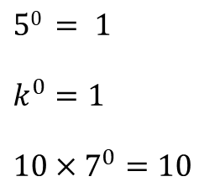

24
7
30
Date
Index Laws 3 and the zero law
EQ – Describe how the index laws can be used to simplify expressions with indices.
What are the index laws?
Index Law 3
Example
Zero Index Law
Examples
$$a^{0}=1$$
$$50 = 1$$
$$k^{0}=1$$
$$10×7^{0}=10$$
5

Slide 5
Try the following..
1. (21⁴)⁵ = 2. (3³)⁵ =
3. (4⁷)² = 4. (a²)³ =
5. (m⁷)³ = 6. (4³)⁰ =
7. 2³ x (2⁵)² = 8. n²(n⁴)² =

